Slide 1
City Council 1st Reading of Annexation, Transmittal of Comprehensive Plan Amendment and 1st Reading of the MPD
August 04, 2026

Slide 2
Agenda
Path to Today and Path Forward
Landowners Role
Strategic Framework for Greenways, Stewardship & Infrastructure
MPD Agreement
Economic and Fiscal Benefits
Operational Cost Savings to City
Public School Facilities

Slide 3




Introduction: The path to today
City invited Raydient participation in comp plan and future growth planning
DRI’s were identified as not feasible for development
City approved Imagine 2050 comp plan with defined elements for future growth
  Protect Ecosystems & Cultural Resources
  Generate Economic Development & Job Creation
  Diversity of Housing Choices
  Enhance Mobility (traffic) Systems
City prioritized state appropriations for regional infrastructure and approved the contract for loop road that has commenced construction
At the City’s request, Raydient prepared and provided an MPD to plan for future growth and economic development consistent with the goals of the Comp Plan

Slide 4

Two Paths Forward
Path 1: Status Quo
Path 2: City Imagine 2050
Unplanned
OR
Planned
Fragmented, disconnected
Not cohesively planned
Cohesive & integrated land planning
Aligned with City Comprehensive Plan
No long-term strategy
Unpredictable infrastructure investment
Supports higher quality community growth
Coordinated Phased Infrastructure
Both paths are doable – only one achieves the City’s long-term vision.

Slide 5


Raydient’s Role: Landowner
City of Palm Coast | Regulatory Oversight & Compliance
LANDOWNER
DEVELOPERS
BUILDERS
COMMUNITY
Strategic Framework
(Long-term Time Horizon)
Horizontal Infrastructure
(Phased)
Construction Risk
(Phased)
Future of Palm Coast
Vision – Refinement & Market Response
MPD Zoning / Mitigation Framework
Large Scale Land Planning & Design Guidelines
Builder & Developer Programs
Community Governance
Independent Special Districts
Local Infrastructure Development
MPD Obligations
Traffic, Utility & School Mitigation
Economic Development (e.g. mix of uses including healthcare & education)
Residential Developers
Non-residential Developers
Non-residential Commercial Retail & Industrial
Residential development & construction
Large Scale Cohesive Planning & Identity
Regional Infrastructure
Diversified Tax Base
Economic Development
Live, Work Play Design
Celebrates History and Cultural Resources

Slide 6
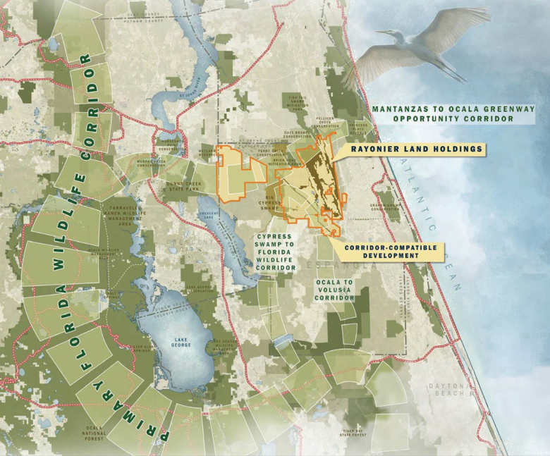
Strategic Framework: Greenways & Stewardship
Nature is the organizing framework for community form
Opportunity to create potentially regionally significant wildlife corridors, greenways and linkages
Promotes a potentially regionally significant strategy outside the MPD to further protect the Florida Wildlife Corridor and sensitive areas
Greenway overlay, infrastructure and community growth are integrated

Slide 7
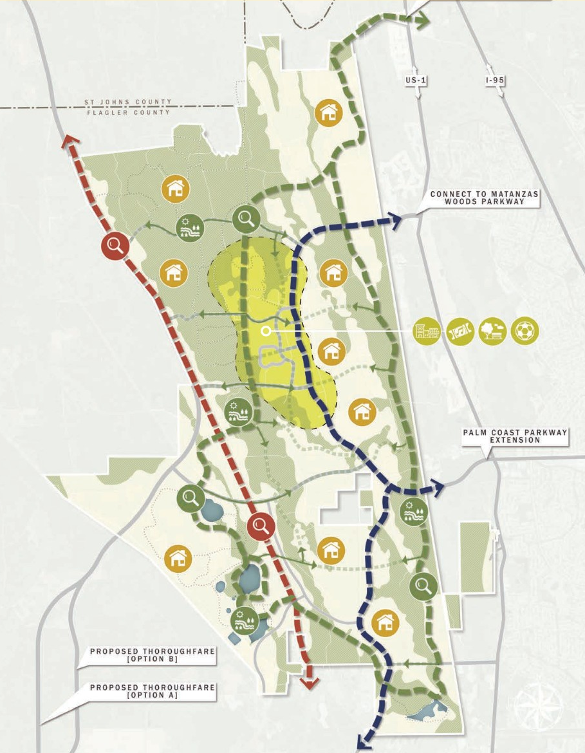
Strategic Framework: Enhanced Regional Infrastructure
Uses Natureways to combine transportation, stormwater, habitat, and public space into one system.
Growth Designed Around the Land
Network provides multimodal mobility network emphasizing safety, walkability, and low-stress travel. Loop Road and Regionally Significant Roadway Network.
Coordination with City/County with historic assets like Old Brick Road and the future plans for CR 2209 are key to connecting future mobility corridors.
The Regional Sports Park could become a community wide amenity creating economic diversity and incremental revenues while promoting local youth development.
Phased infrastructure to support growth reduces fiscal risk

Slide 8
MPD Entitlement by Acreage
Table 1 Sub-Areas
Land Use Sub-Area | Acreage | Net Developable Acreage
Regional Activity Center | 947 | 8.1%
Village Center | 926 | 8.0%
Villages | 8,881 | 76.3%
Employment Center | 889 | 7.6%
Greenway Overlay | 8,501
Total | 20,144 | 100%
50% of the Gross Acres are committed to Greenway, Open Space and Recreation
Net Development acreage is 10,072 of the 20,144 acres
Regional Activity Center includes both commercial and light industrial uses
Village Centers are designed as mixed-use villages and neighborhood commercial centers
Villages promotes a diversity residential uses including life stage and attainable housing
Employment Center focuses on Job Creation and Industrial uses utilizing regional infrastructure and is located on the rail line
Approx. 25% of land is aggregated for non-residential uses

Slide 9
MPD Entitlement by Land Use
Table 8 Land Use and Phasing – Increased Employment Center Uses & Decreased Residential Uses
Use Type | Units | Phase 1 2026-2036 | Phase 2 2036-2046 | Phase 3 2046-2056 | Buildout Total
Single Family Detached | DU | 4,465 | 3,915 | 7,060 | 15,440
Single Family Attached | DU | 661 | 1,739 | 80 | 2,480
Multi-Family | DU | 1,180 | 820 | 0 | 2,000
Office | SF | 400,000 | 0 | 338,000 | 738,000
Commercial | SF | 810,000 | 478,000 | 588,000 | 1,876,000
Industrial | SF | 1,500,000 | 2,750,000 | 1,350,000 | 5,600,000
Hospital | Beds | 100 | 0 | 0 | 100
Hotel | Rooms | 920 | 115 | 0 | 1,035
Soccer Complex | Fields | 20 | 0 | 0 | 20
Sports/Entertainment Venue | Seats | 28,000 | 0 | 0 | 28,000
Golf Course | Holes | 18 | 0 | 0 | 18
MPD Design
50% Parks, Recreational Facilities, Trails & Open Space
Regional Sports Activity as a catalyst
Diversified Tax Base and Economic Development
Job Creation through Employment Center uses
Diversity of Housing
Promotes Live, Work, Play
As a result of continued collaboration and feedback, the entitlement exchanged 2,000 units of residential uses to bolster the Employment Center acreage and Industrial Uses. This creates a ~900-acre commerce park leveraging regional mobility infrastructure in the Southeast portion of the property.

Slide 10
MPD Comparison to the DRIs – Infeasible DRI’s v. MPD consistent with City Comprehensive Plan Vision
 |  |  |  | % Change
Use Type | Units | Existing DRI's | MPD | to DRI
Acreage | AC | 11,683 | 20,144 | 72%
Residential | DU | 12,000 | 19,920 | 66%
Commercial | SF | 454,000 | 1,876,000 | 313%
Office | SF | 656,000 | 738,000 | 13%
Industrial | SF | 2,309,000 | 5,600,000 | 143%
Hospital | Beds | 0 | 100
Hotel | Rooms | 0 | 1,035
Soccer | Fields | 0 | 20
Sports Entertainment | Seats | 0 | 28,000
MPD Design
50% Parks, Recreational Facilities, Trails & Open Space
Regional Sports Activity as a catalyst
Diversified Tax Base and Economic Development
Job Creation through Employment Center uses
Diversity of Housing
Promotes Live, Work, Play
The prior DRI’s lacked a diligence of planning to appropriately match uses with the characteristics of the land, minimize the impacts of infrastructure development and promote economic development. The DRI’s contained multiple zoning restrictions “poison pills” that stifle development, decrease market competitiveness and are not feasible for the future growth of Palm Coast.

Slide 11
Summary of Taxable Values – Economic Diversity
75%
25%
The MPD estimates a 75/25 residential to non-residential split compared to the existing 90/10 in the City of Palm Coast. Non-residential development includes 8.2M SF of uses facilitating an estimated ~17,000 direct new jobs (64% increase) and 8,700 indirect jobs from the total economic impact.

Slide 12
Summary of Fiscal Net Benefits
The table above represents taxable values with an alternative perspective if the Homestead Exemption is approved in the November ballot and constitutional amendment referendum indicated as the “Adjusted Net Benefits”.

Slide 13
City Operational Cost Savings and School Facilities
Roadways:
Local roads are built by the development and maintained by the Special Taxing District – This reduces the burden of constructing and maintaining roadways by the City of Palm Coast.
It’s contemplated that only the Regionally Significant Mobility Network will be maintained by the City, County or State, i.e. Loop Road, CR2209. Connecting and off-site mobility enhancements will become part of mobility network funded through Impact Fes and Tax Increments
The MPD contemplates the creation of Special Taxing Districts or a single Stewardship District across the 20,144 acres.
Stormwater:
A master stormwater system will be engineered throughout the community
The Special Taxing District is intended to own and maintain the facilities – This reduces the burden of maintaining a stormwater system by the City of Palm Coast
Public School Facilities:
The School District has multiple sources for the construction of public-school facilities
Impact fees, a portion of property tax and a portion of sales tax collected are dedicated towards the construction of school facilities and estimated to be $466M
The School District has an estimated $361M of net benefit after the school facility costs

Slide 14
Agenda
Components of a Master Plan.
  Regional Greenway/Wildlife Corridor Connectivity
  Regional Mobility Connectivity
  Constraints & Opportunities
  Encourage Smart Growth
  Loop Road/Utilities and Water Supply
  Annexation
  City Initiated Future Land Use Map Change
  MPD Agreement
  Benefits

Slide 15
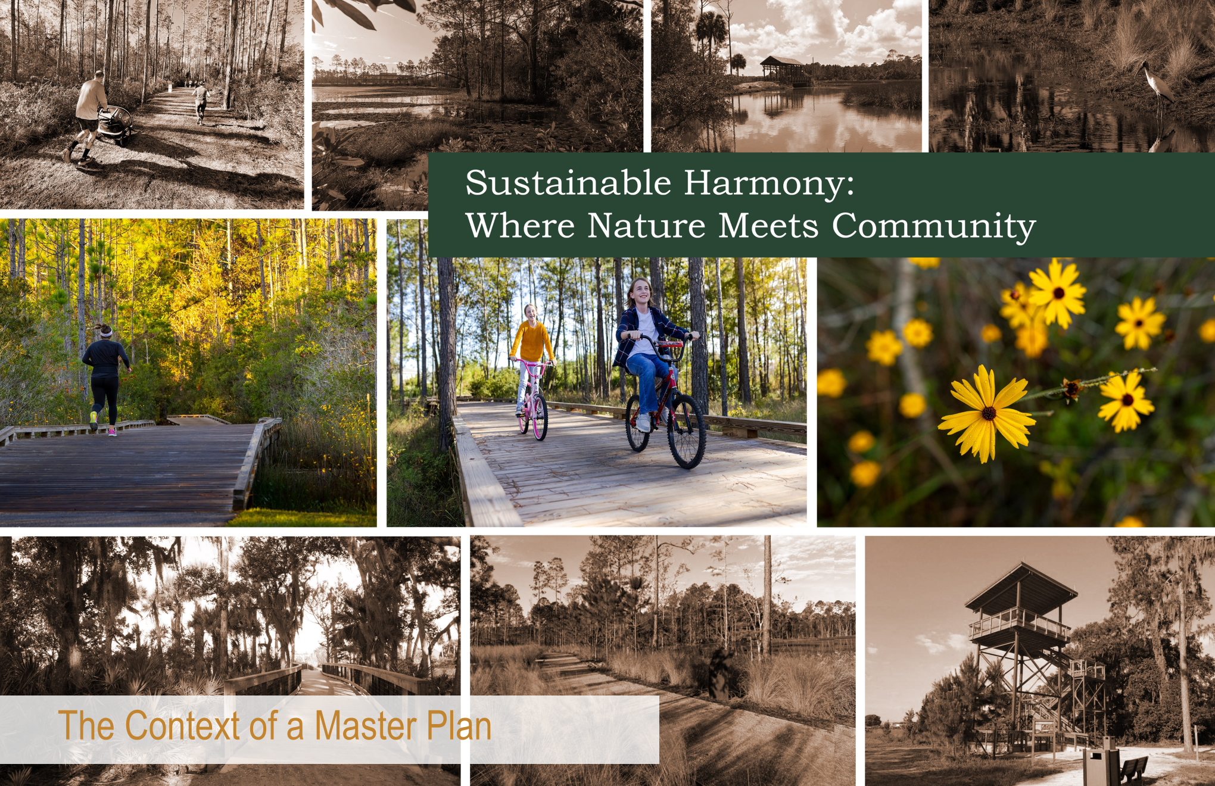
Sustainable Harmony:
Where Nature Meets Community

Slide 16
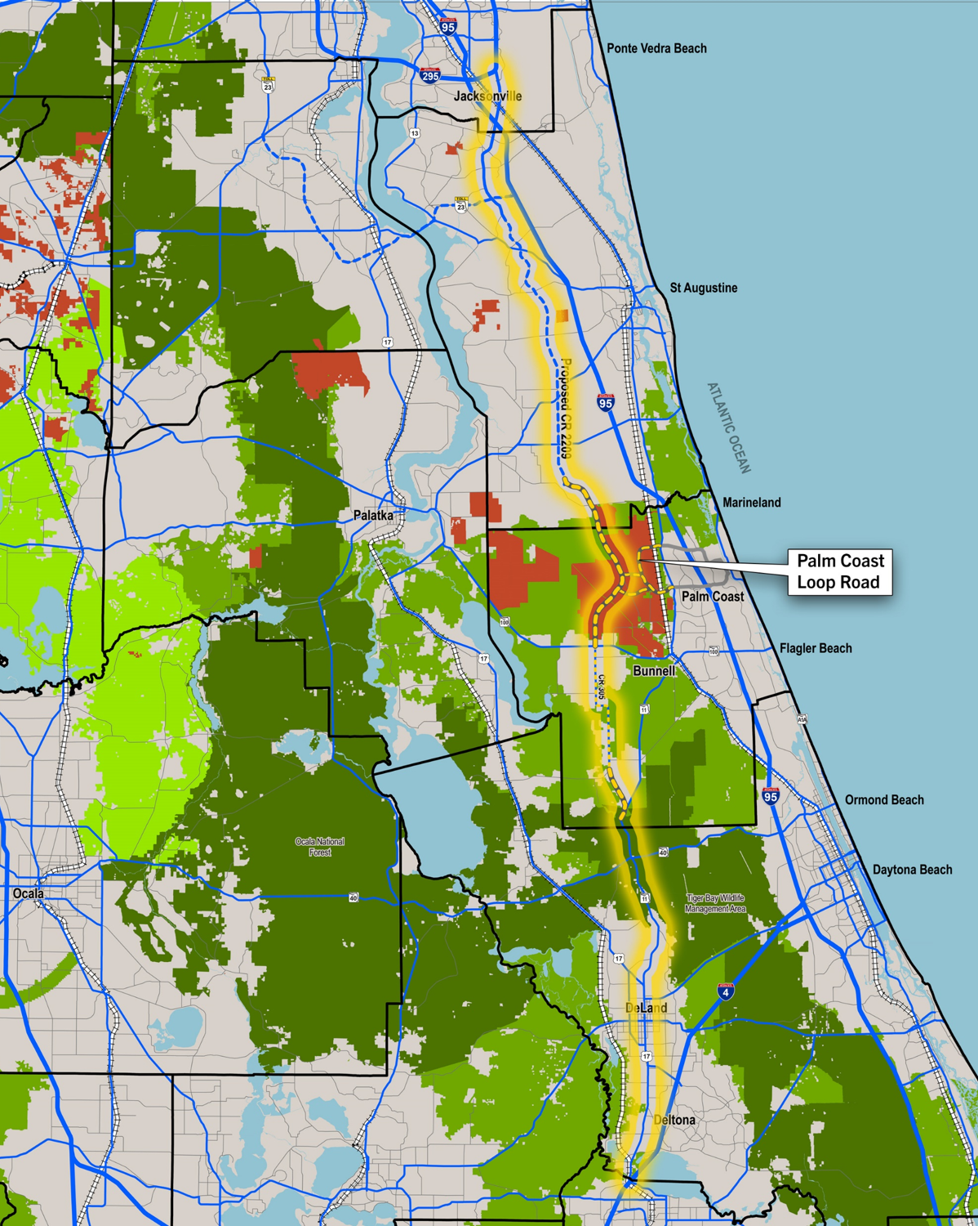
Regional Context
Primary defining components of a Master Plan:
    1. Regional Greenway & Open Space Connectivity
    Florida Wildlife Corridor Connections
    Addition to Matanzas to Ocala N.F. Wildlife Corridor
  2. Regional Mobility Network Connectivity
    CR 2209 Extension
    Loop Road Connectivity
    Expansion of the State Priority Trail System

Slide 17
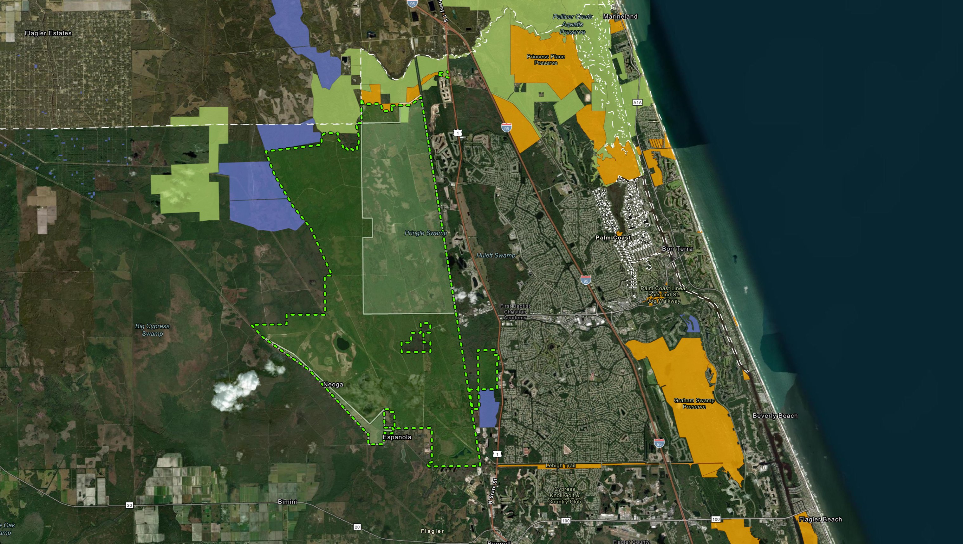
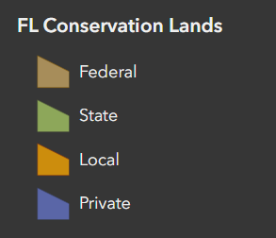
Existing Conservation

Slide 18
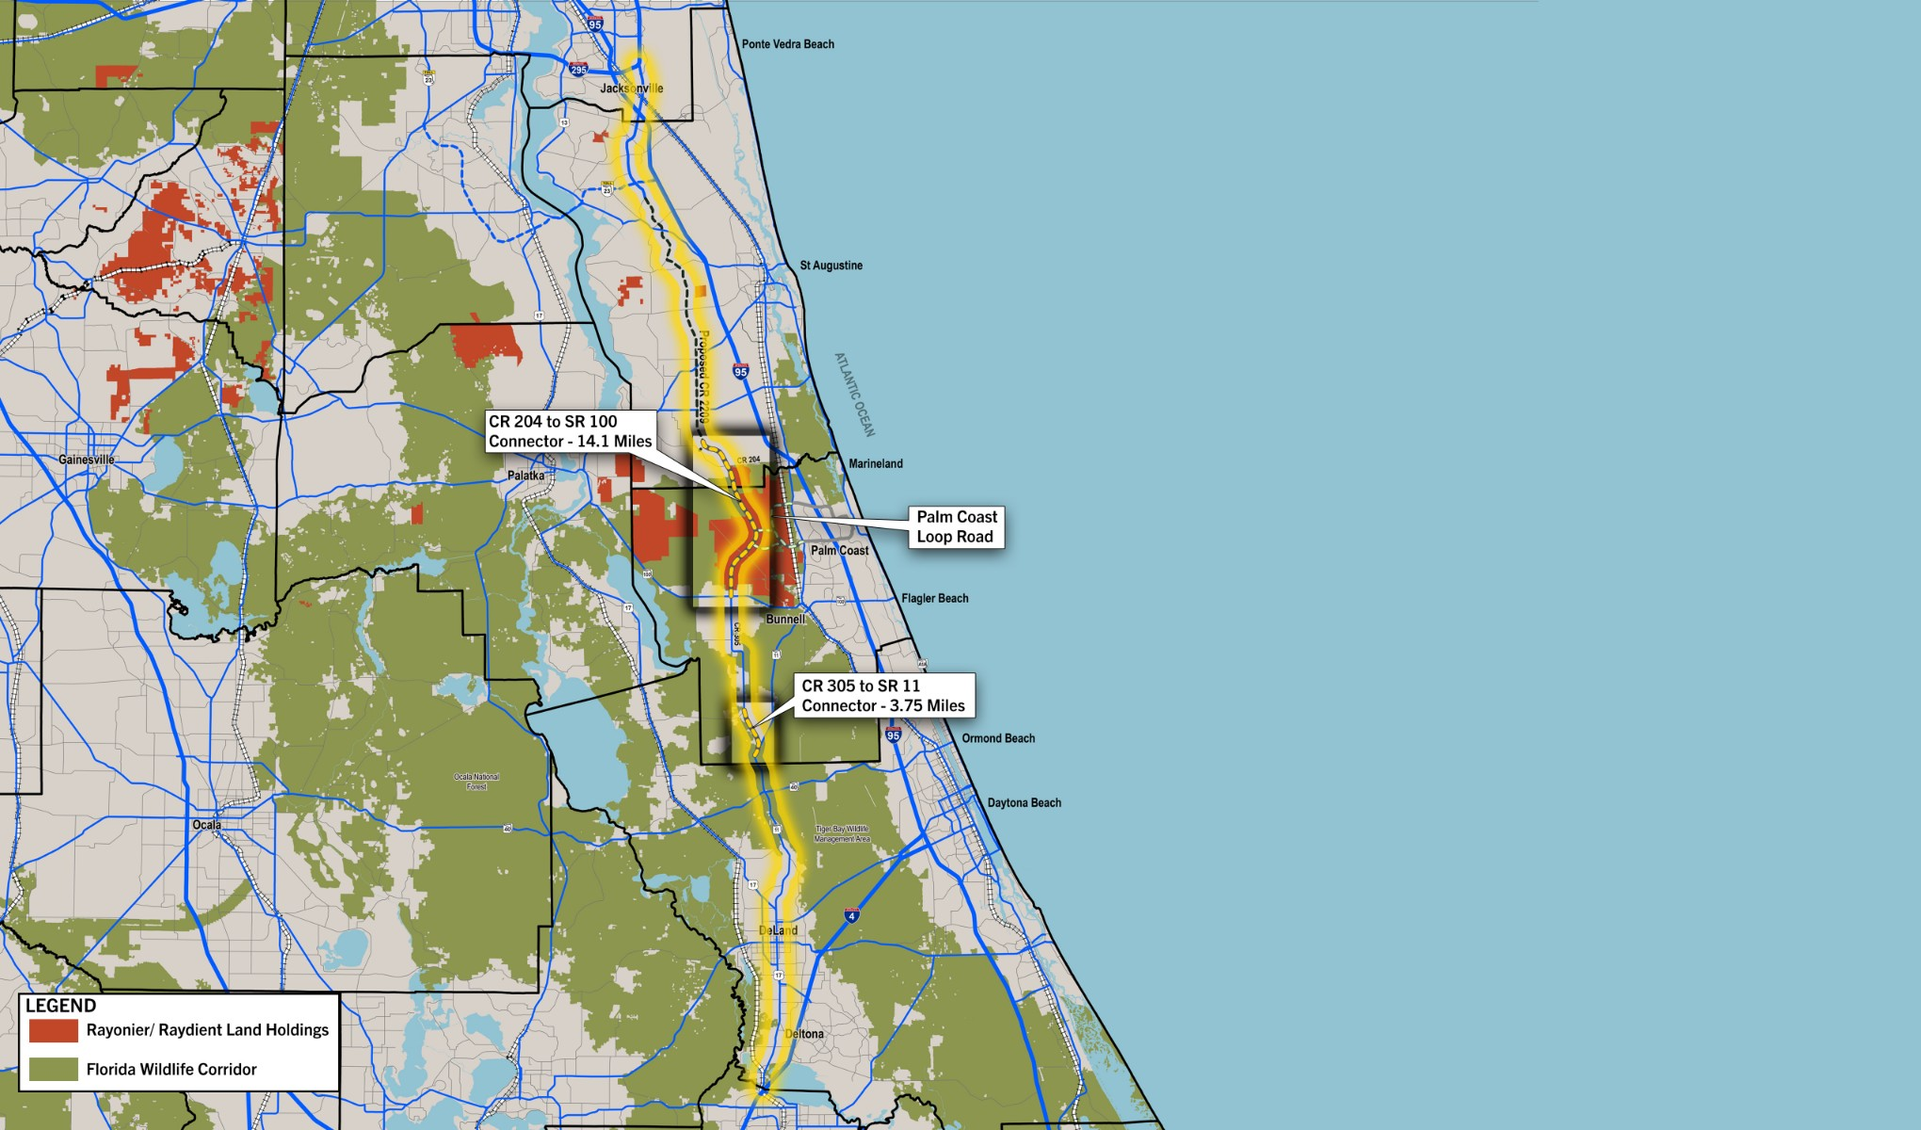
CR 2209 Extension

Slide 19
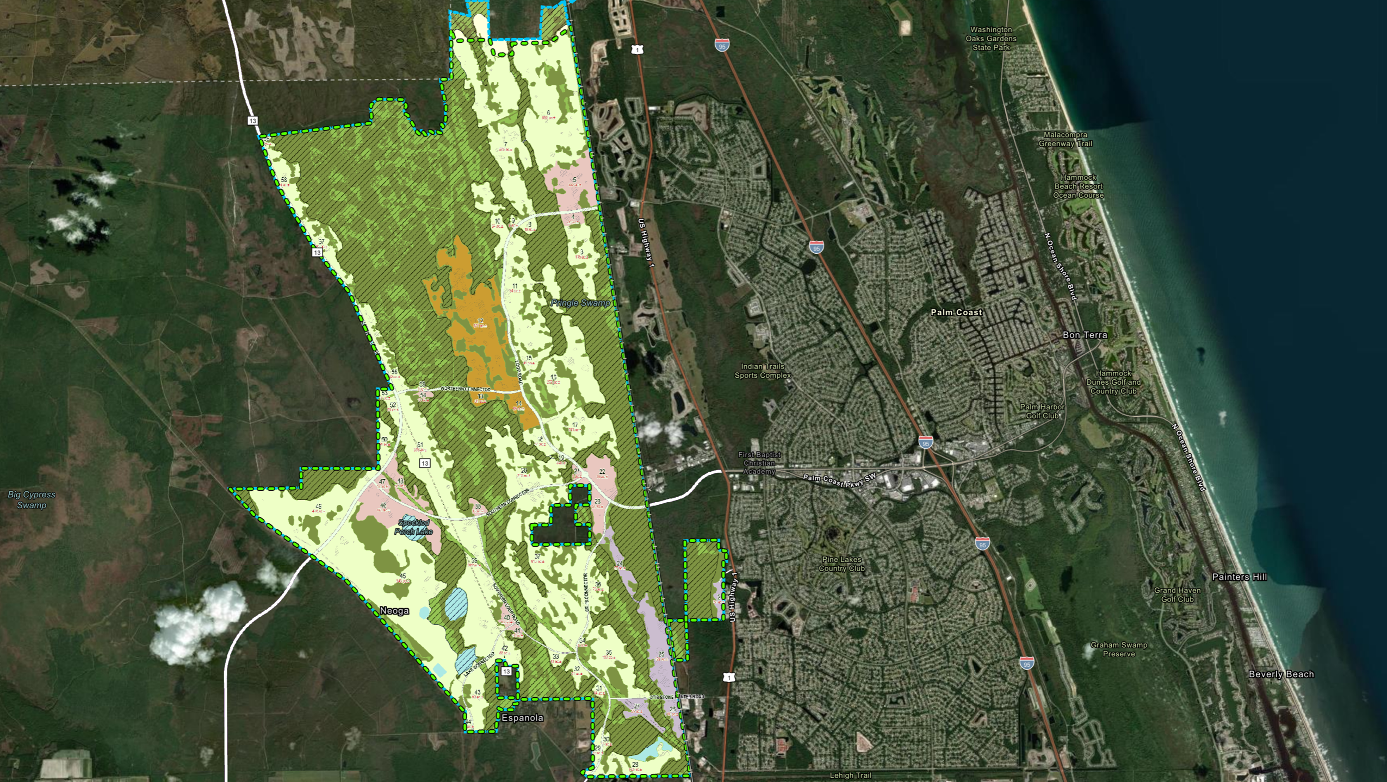
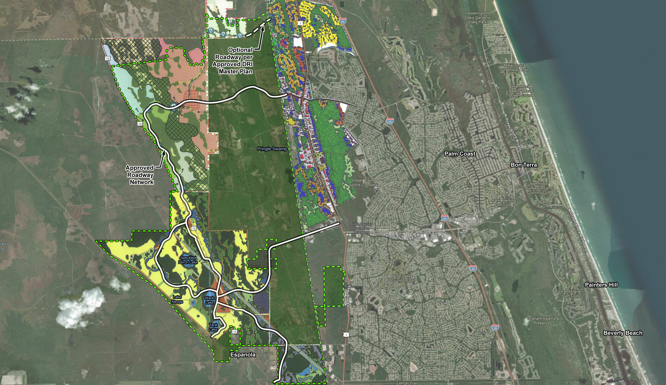
Approved DRI Master Plans

Slide 20
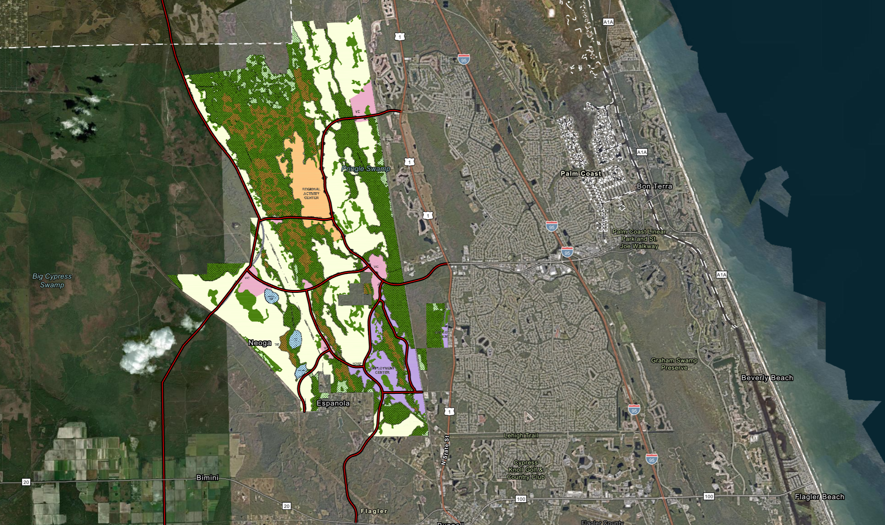
Proposed Master Plan

Slide 21
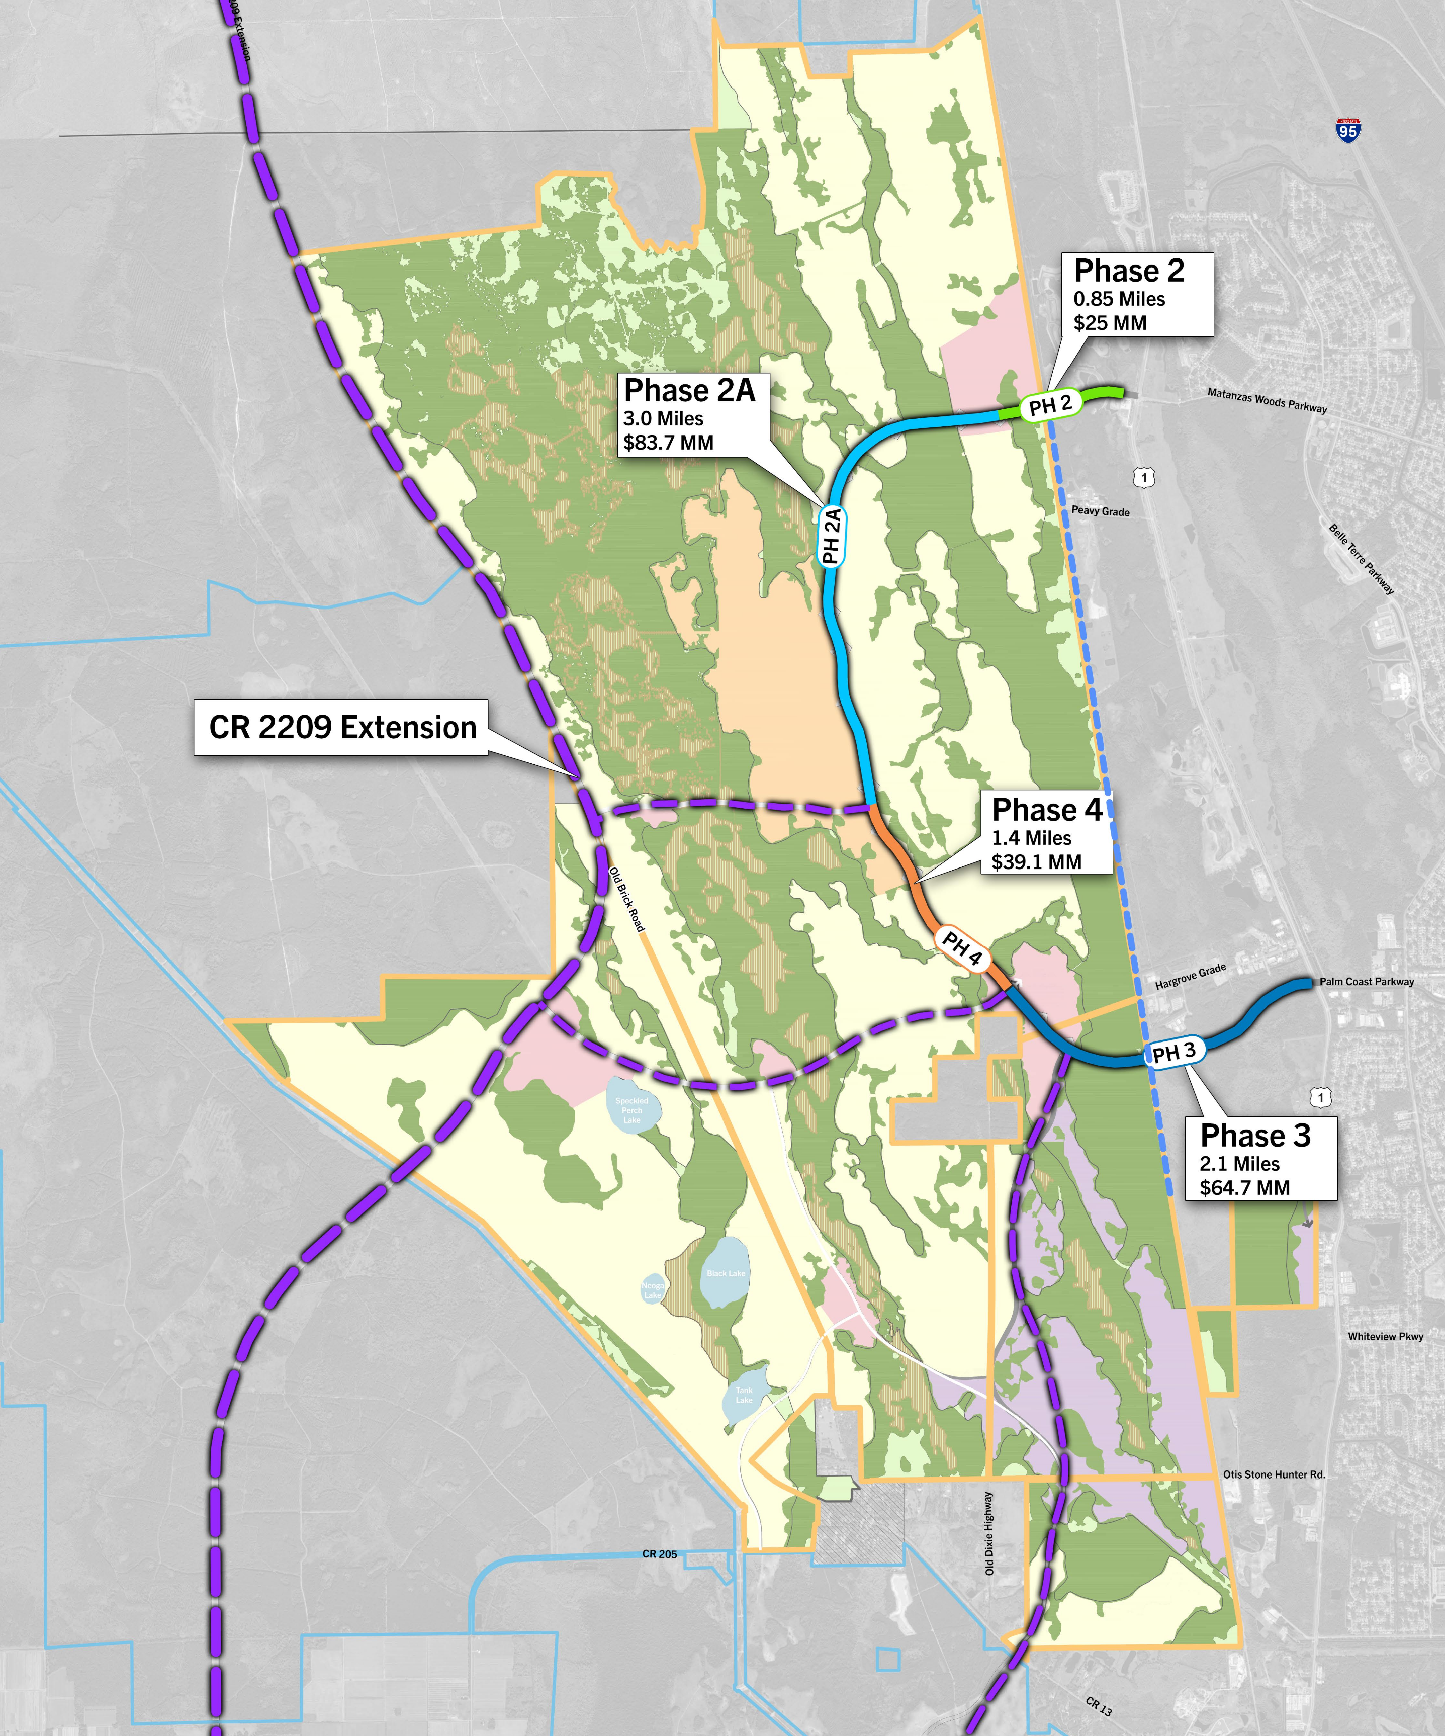
Loop Road
Total State Appropriation: $105M
City Funding: $6.5M
FDOT Funding: $20.0M
Total: $131.5M
Total Estimated Cost: $227.5M
State Funding Needed: $96M

Slide 22
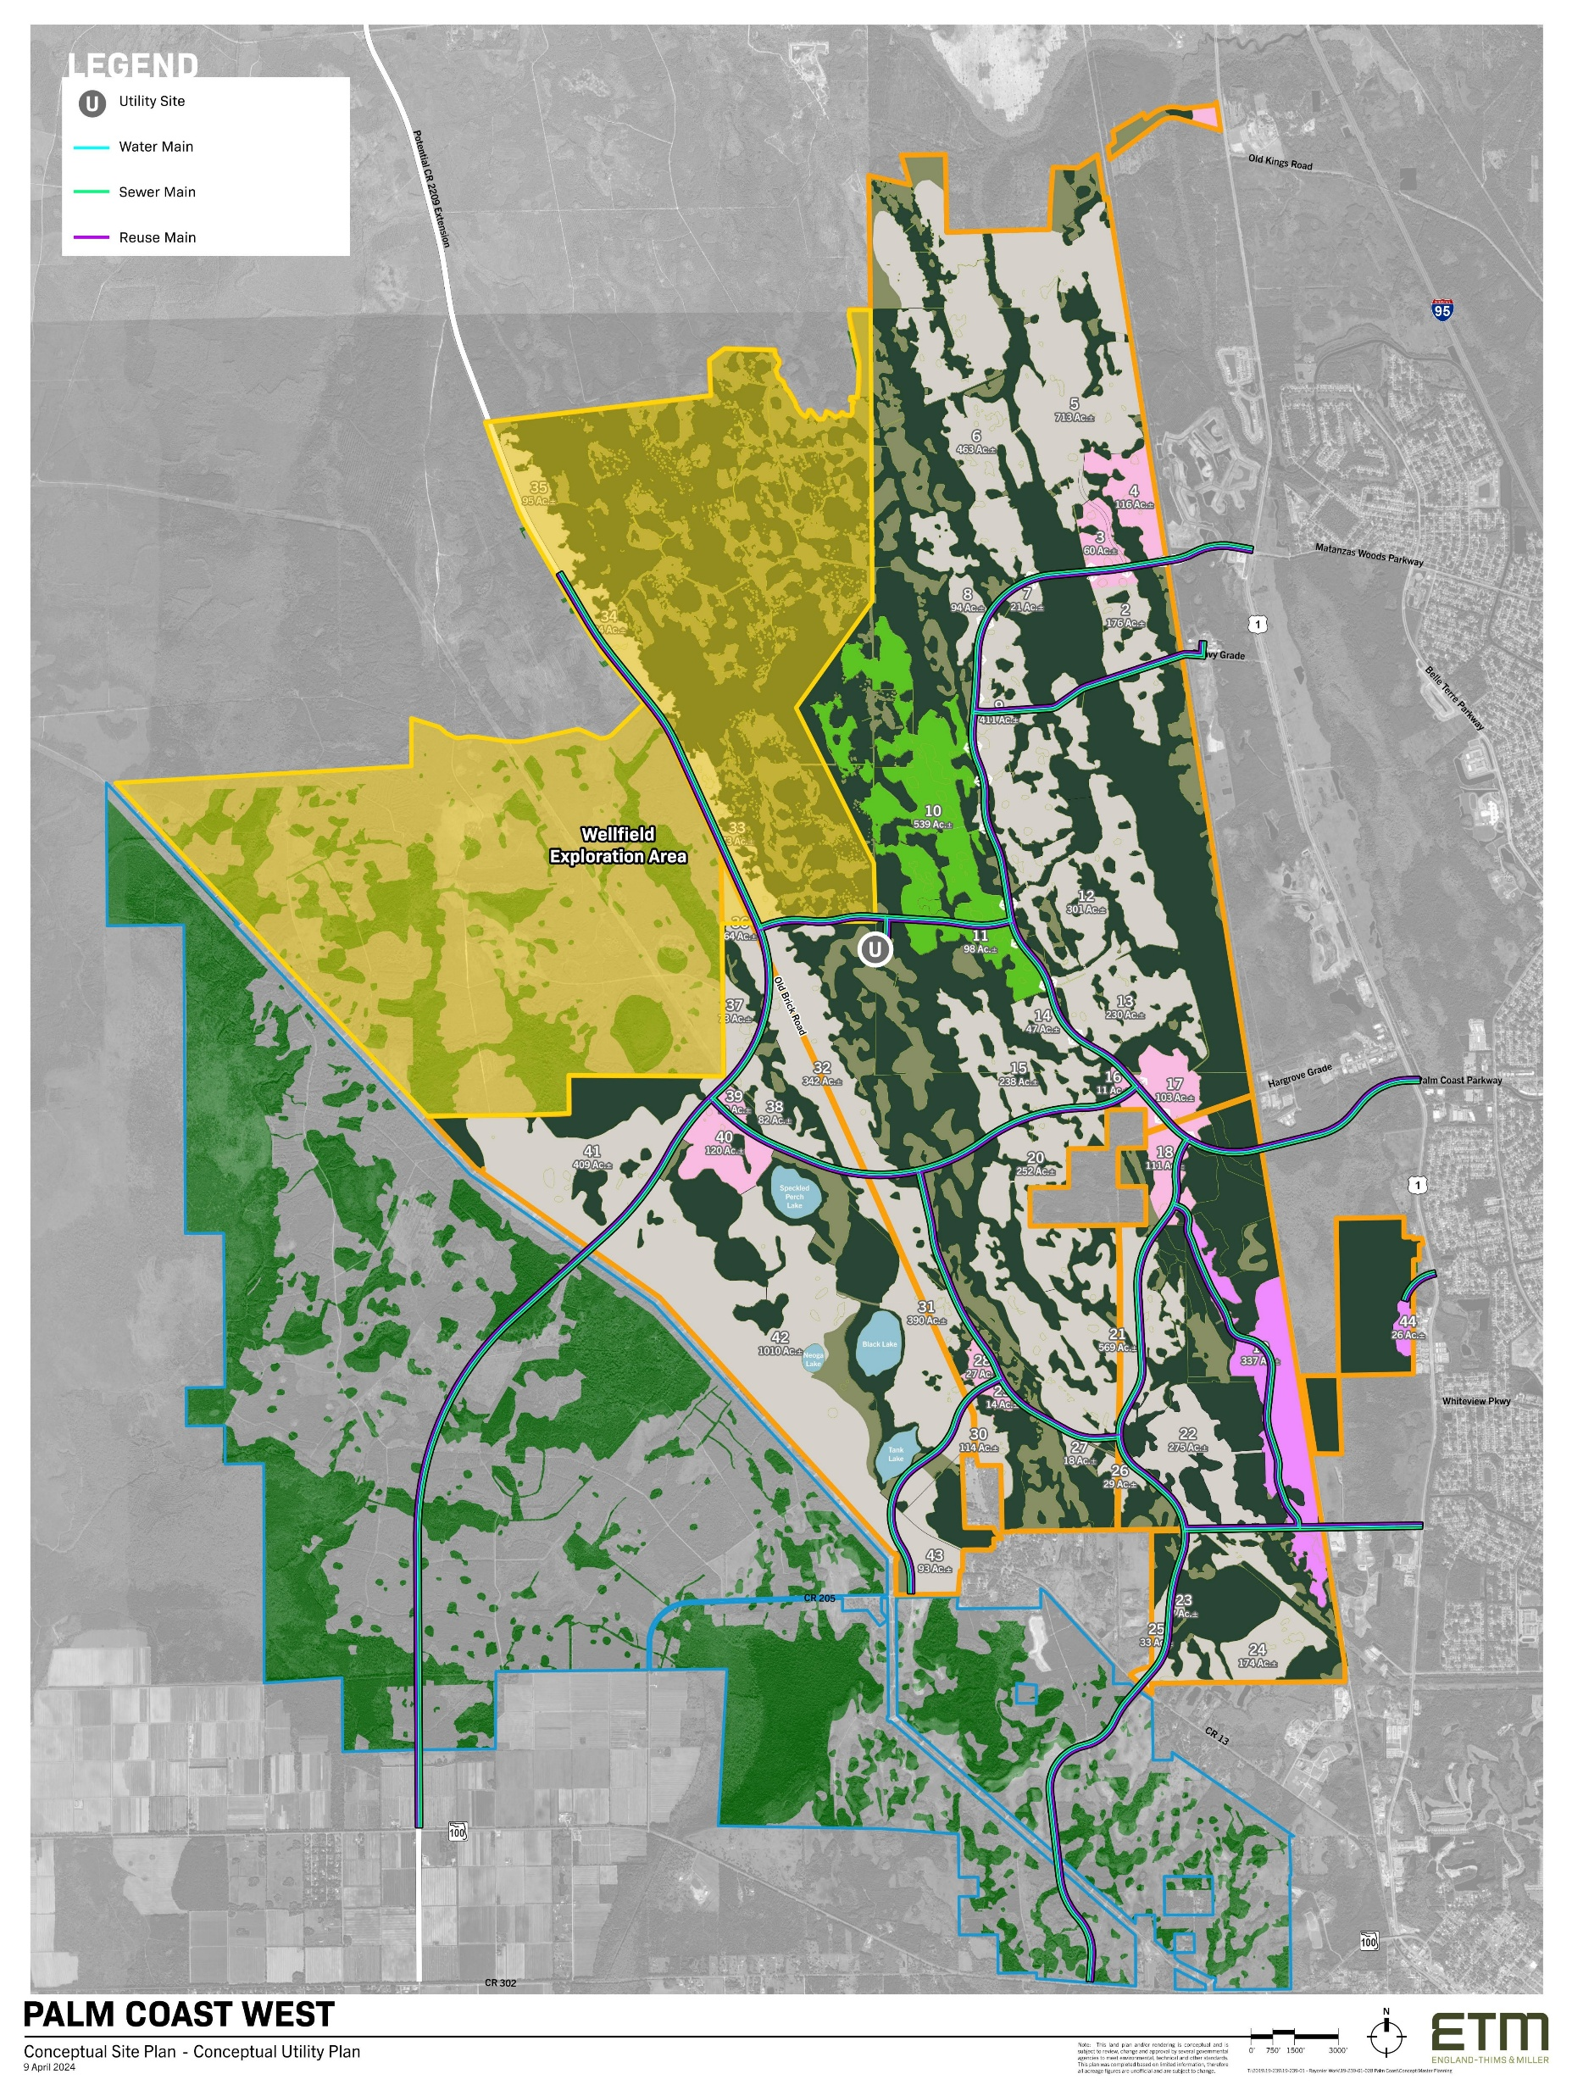
Water Supply
Coordinating with the Utility Department on a new
Wellfield Exploration Area
Exploring site for new utility plant

Slide 23
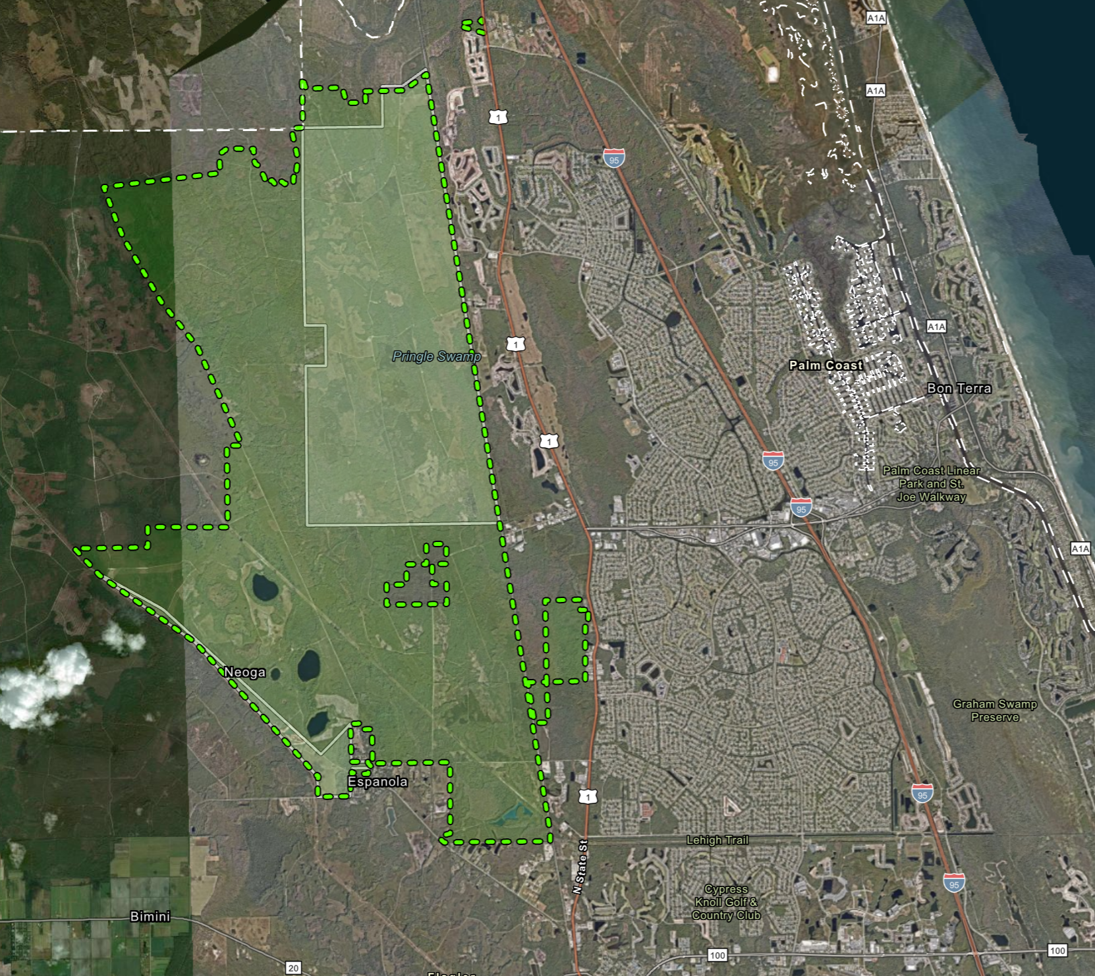
Annexation Lands
6,601 acres
Two Parcels of Land
6,601 acres
440 acres
7,041 acres total
440 acres

Slide 24

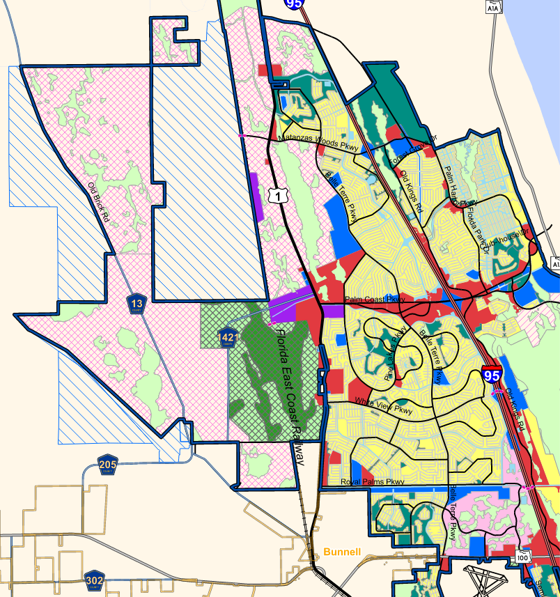
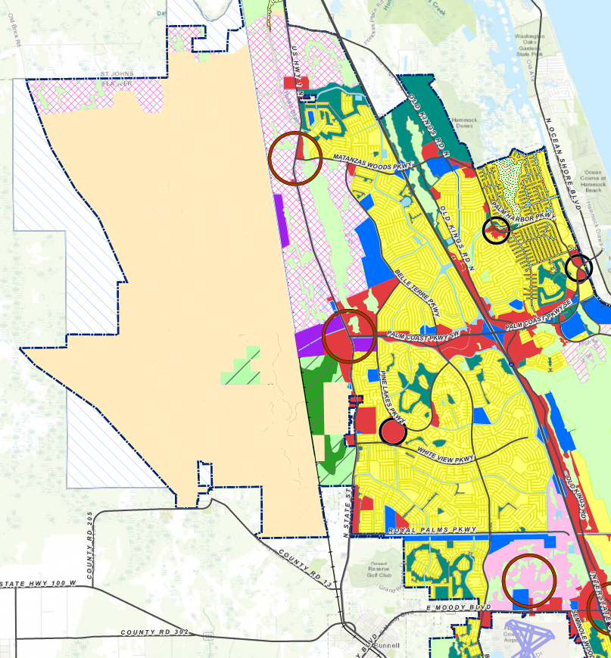
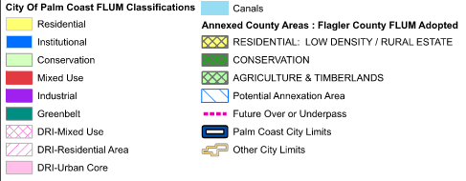
Adopted Future Land Use
Proposed Future Land Use

Slide 25
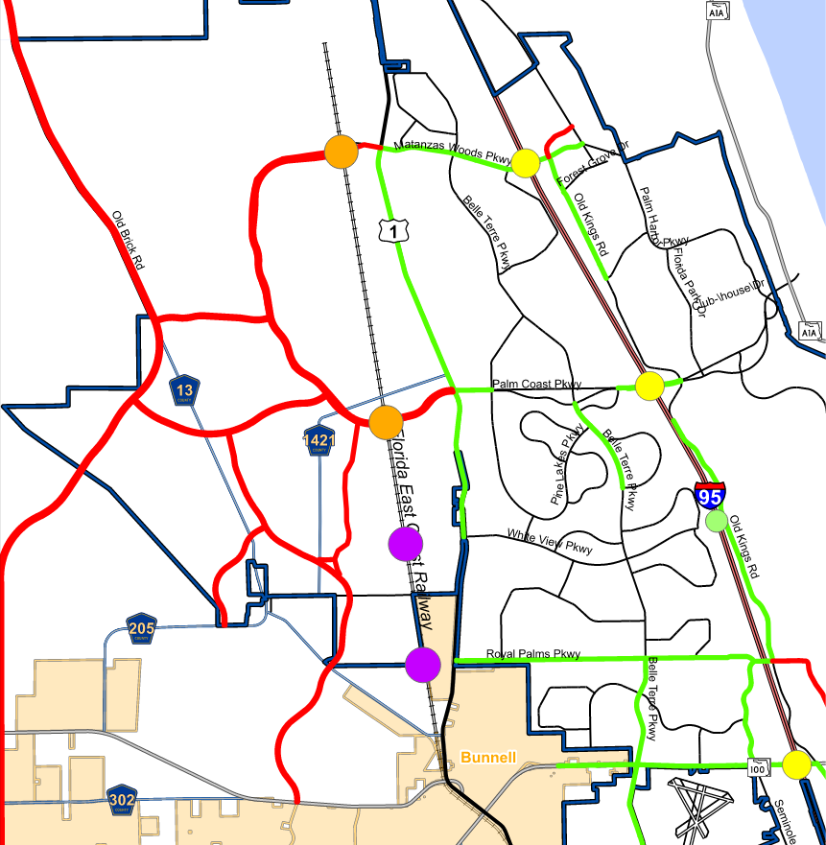
2050 Transportation Facilities

Slide 26
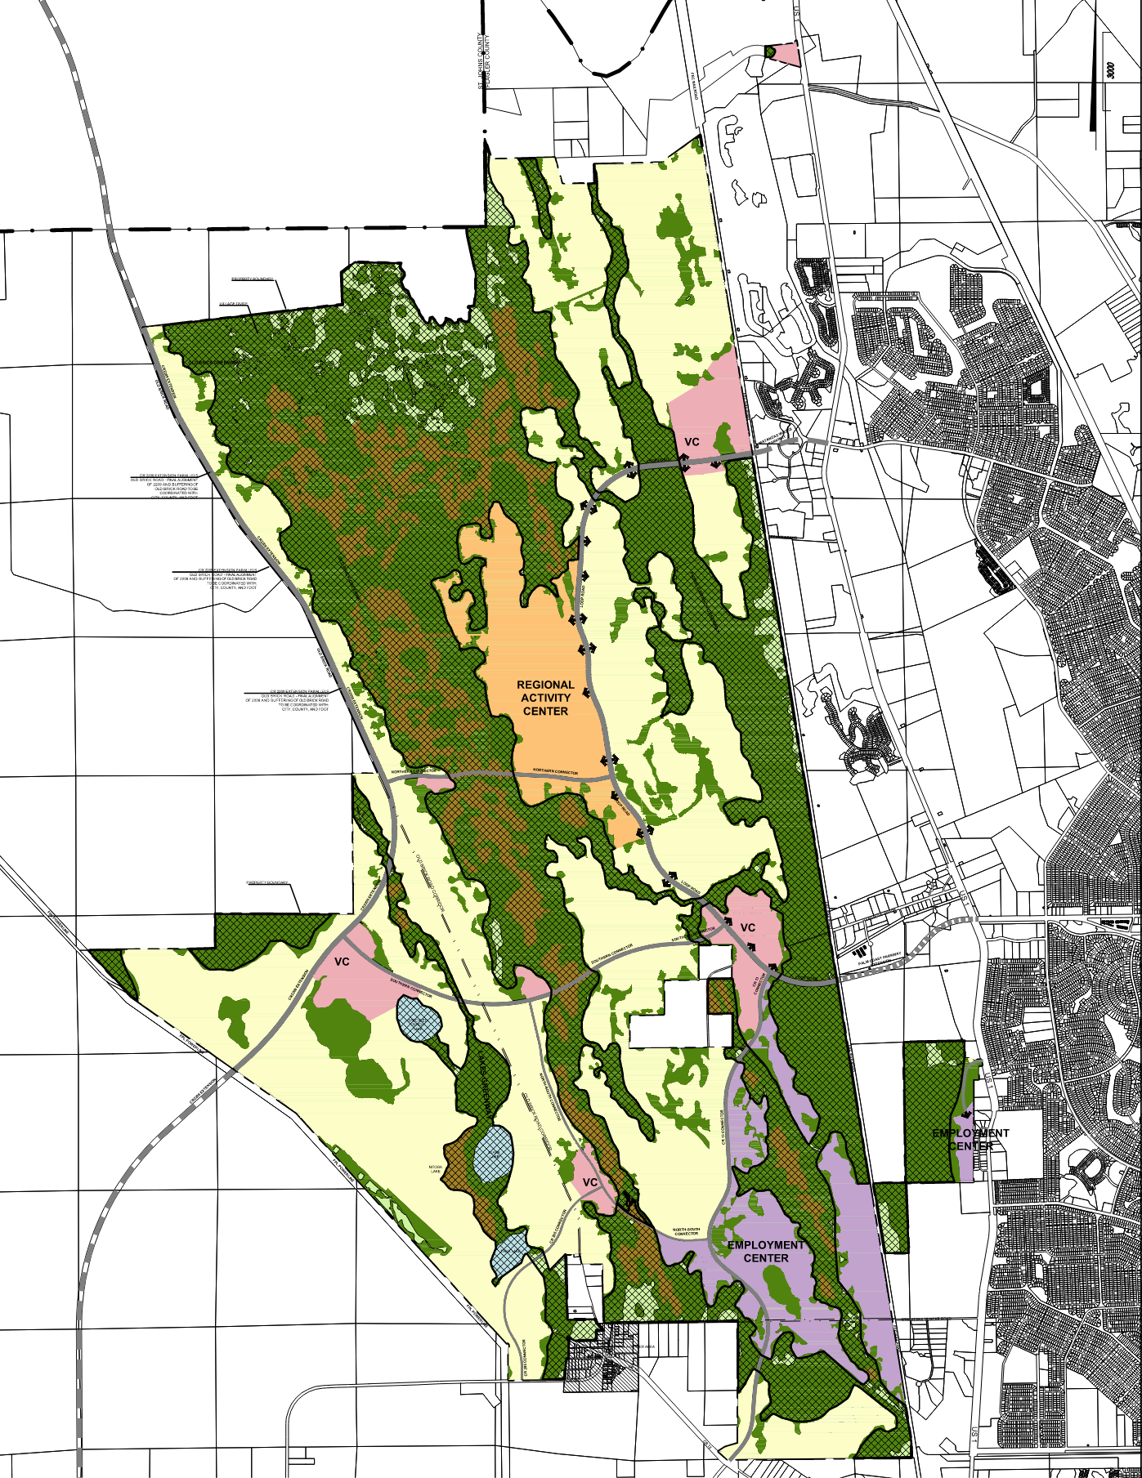
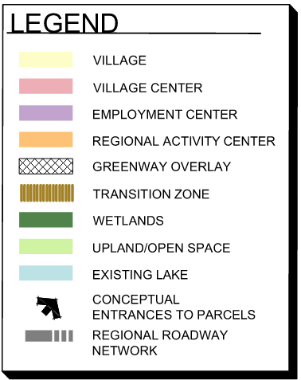
MPD Master Plan Map

Slide 27

MPD Agreement
Land Use Sub-Areas (Zoning Districts)
    Permitted Uses
    Site Development Standards
Minimum Lot Area and Width
Maximum Lot Coverage
Minimum Setbacks
Maximum Height
Other Development Standards
Development Plan Review Process
  Substantial Compliance Review
  Technical Site Plan

Slide 28
MPD Agreement
Land Use and Phasing
Use Type | Units | Phase 1 2026-2036 | Phase 2 2036-2046 | Phase 3 2046-2056 | Buildout Total
Single Family Detached | DU | 4,465 | 3,915 | 7,060 | 15,440
Single Family Attached | DU | 661 | 1,739 | 80 | 2,480
Multi-Family | DU | 1,180 | 820 | 0 | 2,000
Office | SF | 400,000 | 0 | 338,000 | 738,000
Commercial | SF | 810,000 | 478,000 | 588,000 | 1,876,000
Industrial | SF | 1,500,000 | 2,750,000 | 1,350,000 | 5,600,000
Hospital | Beds | 100 | 0 | 0 | 100
Hotel | Rooms | 920 | 115 | 0 | 1,035
Soccer Complex | Fields | 20 | 0 | 0 | 20
Sports/Entertainment Venue | Seats | 28,000 | 0 | 0 | 28,000
Golf Course | Holes | 18 | 0 | 0 | 18

Slide 29










Benefits of Westward Expansion
MPD designed to help implement the vision and guiding principles of Imagine 2050 comp plan update
At least 50% of the acreage is set aside as open space and recreation
Greenway connected to existing off-site conservation lands within the Florida Wildlife Corridor
Regional multi-modal mobility network connectivity
Opportunity for a regional destination with a sports activity center as a catalyst for economic development
Efficient provision of public facilities & cost savings from private internal street & stormwater maintenance
Assisting with a long-term solution to water supply and wastewater capacity
Provides method to meet public facility mitigation at adopted LOS
Potential to create an estimated 17,000 jobs and more than 8,700 indirect jobs
Provides an estimated positive net fiscal benefit of $667M to the City
Estimated net fiscal benefit of $976M to the County and $385M to the School District

Slide 30

Requests
Three (3) requests for action:
  Approval of 1st reading of Annexations.
  Approval to transmit the Future Land Use (FLUM) map amendment to Master Planned Mixed Use (MPMU) future land use designation for state agency review and comment.
  Approval of 1st reading of MPD Zoning/Agreement.
Final adoption hearings on October 6, 2026:
  FLUM map amendment
  2nd reading/hearing for Annexations.
  2nd reading/hearing for adoption of MPD Agreement.
  DRI abandonments.
October 6, 2026 City Council meeting to begin at 6 pm in City Hall – John Netts Community Wing (160 Lake Ave.)

Slide 31
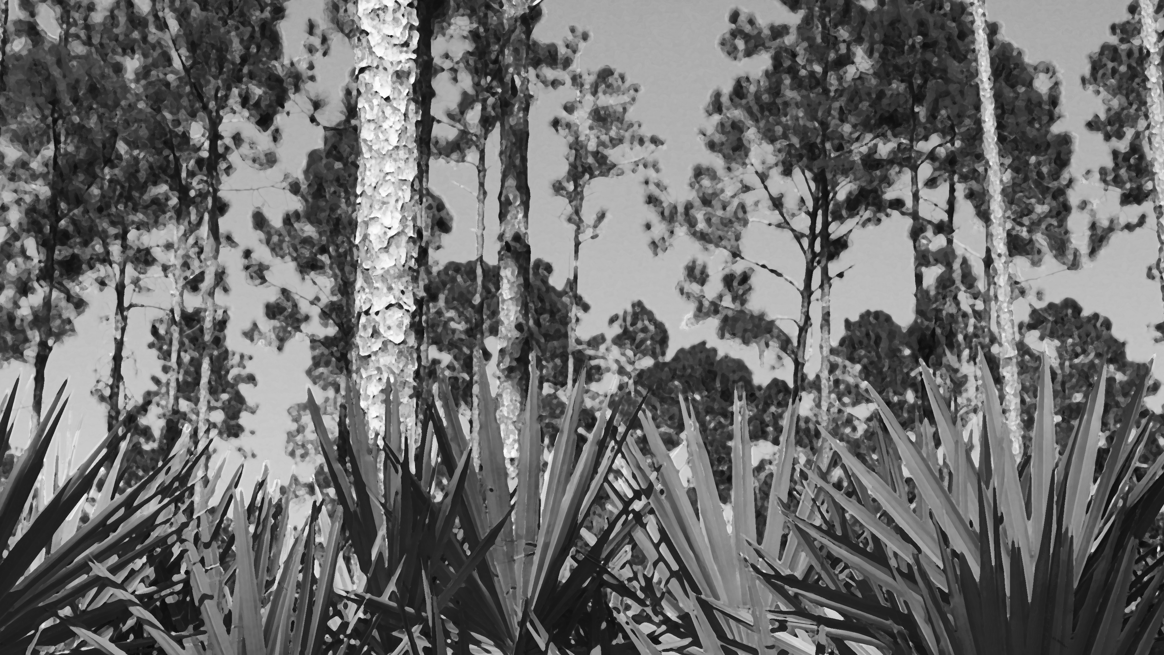
Questions?

